Slide 1

A Model for Data-Informed Policies – Gabby’s Story
The COVID-19 pandemic has created a time of great uncertainty.
A Kearney team member reflects back on a personal time of uncertainty, when her 6 year old daughter, Gabby, was diagnosed with Acute Lymphoblastic Leukemia (ALL) in August 2008.
Thankfully, the professionals at St. Jude’s utilized an approach that was one of the first to focus on a risk-based approach to leukemia treatment, recognizing that most patients don’t die of the disease but of the treatment and reduced quality of life. Gabby’s protocol which focused on a high quality of life was highly successful with over a 95% cure rate.
In both situations, Gabby’s cancer treatment and COVID-19, there was the need for the following;
Quality of Life – What freedoms are we willing to sacrifice on the path to recovery?
A Balanced Approach – When is the time for a conservative approach, and when is it time to accept some level of risk?
Agile Goal-Making – What goals can we work to, knowing that they may include a new normal?
Lessons Learned – What worked in the past?
Gabby at St. Jude’s in Memphis, Tennessee
We choose the Light the Path challenge to apply successes of St. Jude’s risk-based approach to combating the ongoing uncertainties of COVID-19 to develop more sustainable and effective solutions.
Up Next: Our challenge and approach to our solution.
Notes:
Gabby’s story:
On August 6, 2008, our family received some devastating news. Our little baby had been diagnosed with either leukemia or lymphoma. How different the months and days prior had been compared to this day. Gabby was, and still is, a typical six year old. She loved playing with her older sister and her friends, doing arts and crafts, watching movies, playing video games, swimming, and was looking forward to her first softball season this fall. Over the last 8 months Gabby had a couple of issues that warranted a doctor's visit and another health issue that had not. Today we know that most of these issues were probably symptoms of her leukemia. The minor health issue that hadn't prompted us to make a visit to the doctor was night sweats. Gabby had experienced night sweats since she was very little. We had mentioned them to her pediatrician in passing, neither we nor her doctor had considered it a symptom of a larger medical issue. However, we later learned that night sweats can be a symptom of leukemia. Many common childhood medical ailments can actually be symptoms of leukemia. Three major medical issues finally led to the diagnosis of Gabby’s leukemia. In January 2008, Gabby began to develop a mass beneath her left breast. We took Gabby to the pediatrician to have the mass examined. A sonogram and a visit to the pediatric surgeon put our minds at rest as we believed the mass to only be a either a fibroid or internal bruising. We were to monitor the mass and get back with the doctors should the mass grow. We now believe the breast mass is actually a mass of leukemia cells that the doctors hope will go away with Gabby's chemotherapy. Around the same time period as the breast mass, Gabby also began breaking out in hives. Further testing revealed that Gabby had no allergies. Therefore, we attributed the hives to stress as it seemed to occur when Gabby was in a stressful situation. The hives continued up until Gabby's diagnosis. The doctor's are currently unsure whether the hives were a symptom of the leukemia or not. However, it seems likely that the two are related as recently she has undergone the most stressful time of her life, and yet, we haven't had a breakout since treatment began. Now, fast forward a few months...July/August 2008...the mass had almost doubled in size, and Gabby was complaining of achy joints in her wrist and her ankles. While on vacation, the pain seemed to intensify in her joints and Gabby began to limp and developed a low-grade fever. After a vacation, I immediately made an appointment with the pediatrician on August 5, 2008. Based on Gabby’s overall condition (achy joints, fever, and size increase of breast mass) the doctor drew blood during the appointment for testing. On August 6, 2008, the doctor at the St. Jude’s clinic in Huntsville performed more blood tests and confirmed that Gabby had leukemia. She believed that Gabby had Acute Lymphoblastic Leukemia (ALL). Furthermore, she believed it essential to get Gabby to St. Jude's in Memphis, immediately. According to the doctor at the clinic, we could anticipate a 6-8 week initial treatment period in Memphis. Gabby was transported to Memphis that evening. We learned that the doctors would perform a bone marrow biopsy and spinal tap in the morning to determine what percentage of her bone marrow had leukemia, the type of leukemia, and her treatment plan. The spinal tap would provide results as to whether the leukemia had spread to her brain, and at the same time, the doctors would preventatively administer chemotherapy via the spinal tap to prevent the leukemia from transferring to her brain or to begin treatment if the test detected leukemia in the cerebrospinal fluid (CSF).
Gabby’s treatment lasted for over three years with much of that time spent in Memphis. Gabby’s protocol was one of the first to focus on a risk-based approach to leukemia treatment, recognizing that most patients don’t die of the disease but of the treatment and that quality of life does matter. Gabby’s protocol was highly successful with over a 95 percent cure rate and improved quality of life for most patients.

Slide 2
A Model for Data-Informed Policies – Our Challenge
Our team really resonated with the consideration “How can understanding population movement from the COVID-19 pandemic be useful for future infectious disease spread prediction and response planning?” and the mention of some challenges being policy related.
Problem Statement
Methodology
When responding to a pandemic or natural disaster, can balanced policies (e.g., curfews, travel restrictions) focusing on quality of life, sustainability, and mitigated economic impact achieve similar results as more stringent policies?
We created a model that helps policy makers create and update policy in order to respond timely and appropriately to a pandemic or natural disaster. Our model aligns population movement data, economic data, transmission data, and historical and current policy data.
Our references, how we addressed the challenge, and how we developed our solution are included in the submission form.
Impacts
Quality of life can be better preserved through less restrictive or risk-based policy. Implemented early, policy is more sustainable, and just as - or more effective - in controlling movement which minimizes the impact to the economy. For example, in Spain the GDP could potentially be improved by 2.313 percent based on current 2020 projections.
Our solution supports:
Creating Data Informed Policy
Protecting our Vulnerable Communities
Improving Communication
Improving Economic Performance
Responding in a Timely Manner
Up Next: The inputs and outputs of our data model.
Notes:
Our solution utilized data from NASA, as well as other sources such as IMF and U.S. Embassies in tools such as Tableau, Python and ArcGIS to address the problem statement.

Slide 3
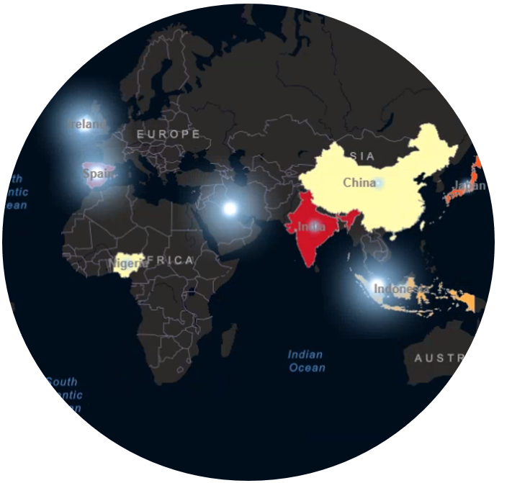
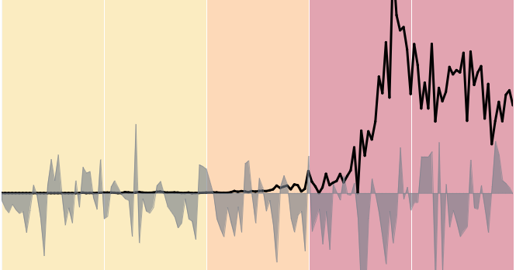
A Model for Data-Informed Policies – Data Inputs
For this challenge, we used movement restriction policy data, people movement data, and pandemic spread trends to measure policy effectiveness. We also modeled the effect policy has on the pandemic spread trend and economic impact to assess a country's approach to government policy decisions.
Data Inputs
Our Model
Policy Decisions
Pandemic Trend and Point-in-Time Data
Data sample we included;
Number of Confirmed Cases
World Population
Movement Restriction Policy
Data sample we included;
Travel Into the Country
Travel Out of the Country
Travel Within the Country
Stay at Home Orders/Curfews
Reopen Plans
People Movement Data
Data sample we included;
Nitrogen Dioxide Troposphere Column using Giovanni Application
Economy (Industry Growth Rate)
Data sample we included;
IMF GDP Data
Quality of life can be better preserved through less restrictive or risk-based policy to restrict movement and improve economic outcomes.
Early implementation of policy makes a difference.
Less restrictive policy results in increased compliance.
Even smaller more-informed policy changes can have a significant impact on quality of life.
More effective policy results in better outcomes.
Up Next: An overview of our data model.

Slide 4
A Model for Data-Informed Policies – Model Scoping
For this challenge, we scoped our data down to 10 countries and focused on decision making at a macro level. The 10 countries selected represent the Top 5 and Bottom 5 countries for cases per million infection rate. Countries must have a population of more than 4 million people and 5,000 cases.
When viewing our data model, put yourself in the shoes of a policy maker.
You know your community’s vulnerability index, what you need is data to make informed and effective decisions about when and how to impose movement restrictions through policy.
During full implementation, this model can be scaled to:
Provide data at various levels (e.g. Internationally, Nationally, Regionally, or Locally)
Incorporate multiple risk factors that helps to provide decision support
Integrate unique data to address community-specific vulnerabilities (e.g. an older population, dense housing situations such as a prison, lack of medical facilities)
Implement risk-based policy decisions
My Community's Vulnerability Index:
Age
Health Status
Economic Status
Supply Chain
Healthcare Stockpile and availability
Population Density
Consumer Resources
Up Next: Our model to measure policy effectiveness.
Notes:
NOTES:
A link to our data model is included in the submission form.
To minimize data reliability issues we selected countries with a population over four million and with over five thousand confirmed cases.

Slide 5
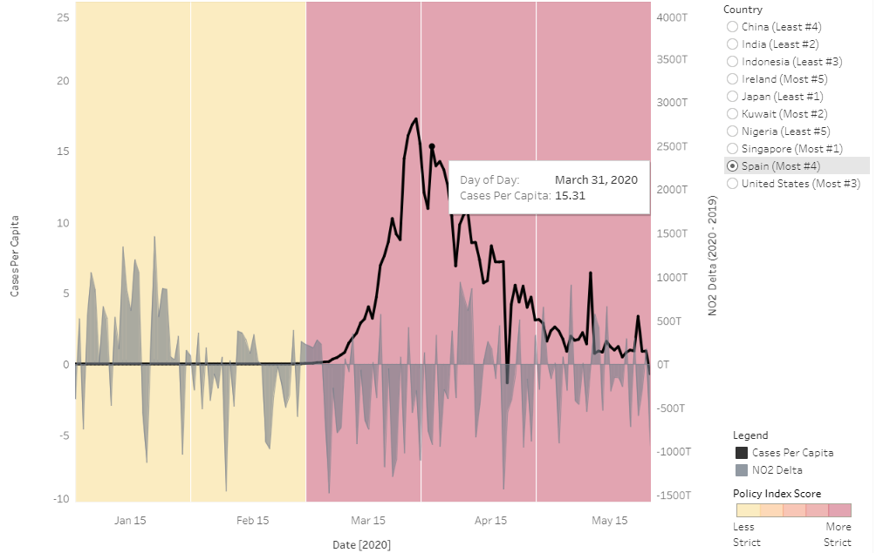
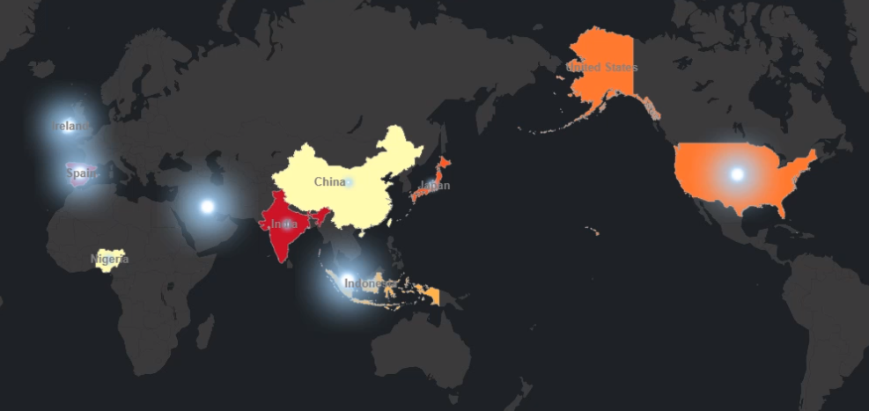
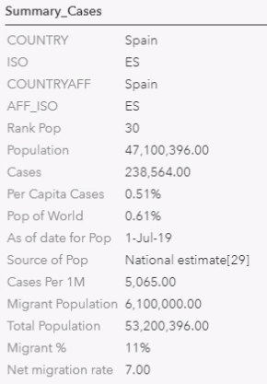
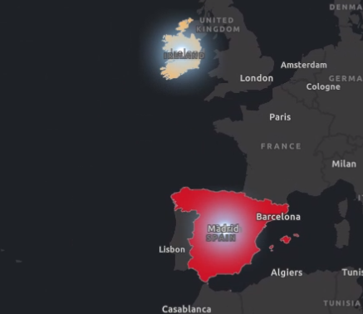
A Model for Data-Informed Policies – Modeling Results
Strict Policy does not appear effective. Policy is more effective and sustainable when implemented early using a more balanced and risk-based approach (e.g., curfews, travel restrictions). Countries with GDP risk would most benefit from balanced, risk-based policies. For example, Spain could potentially improve its projected 2020 GDP by 2.313 percent using a more balanced approach.
Tableau Data Model (Click here.)
ARC GIS Data Model (Click here.)
Our dashboard aligns population movement data utilizing
NO2 delta (2019 – 2020), confirmed cases per capita, and methodology-based Policy Index Score to better understand
the effectiveness of current policies.
Our model demonstrates the effect of informed policy as it relates to the economic impact of affected countries. Higher GDP risk is indicated
by a darker color for each country (i.e., red illustrates the highest risk, yellow indicates the lowest risk).

